Slide 1
Bachelor thesis
Angular Measurement by Magnetic Sensor Arrays and Tolerance Compensation by Gaussian Process

Slide 2
Overview
Application
Characteristics
Data Adaption
Gaussian Processes

Slide 3
Overview
Application
Characteristics
Data Adaption
Gaussian Processes
Software Development
Simulation – Sensor Array
Simulation – Gaussian Processes
Testing Experiments
Summary

Slide 4
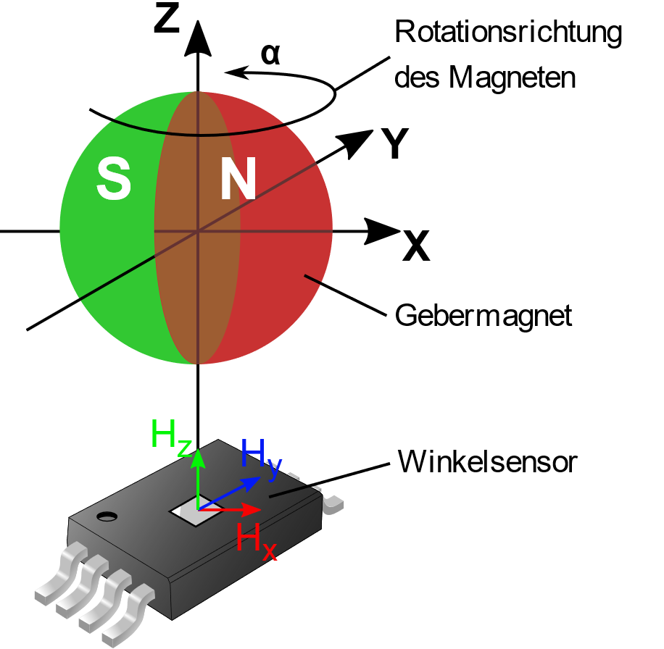
Application

Slide 5
Application
Contactless angle measurement

Slide 6
Application
Contactless angle measurement
Angle encoded by magnetic field
Encoder
Angular sensor

Slide 7
Application
Contactless angle measurement
Angle encoded by magnetic field
Field strength measurement in X-/ Y- direction
Encoder
Angular sensor

Slide 8
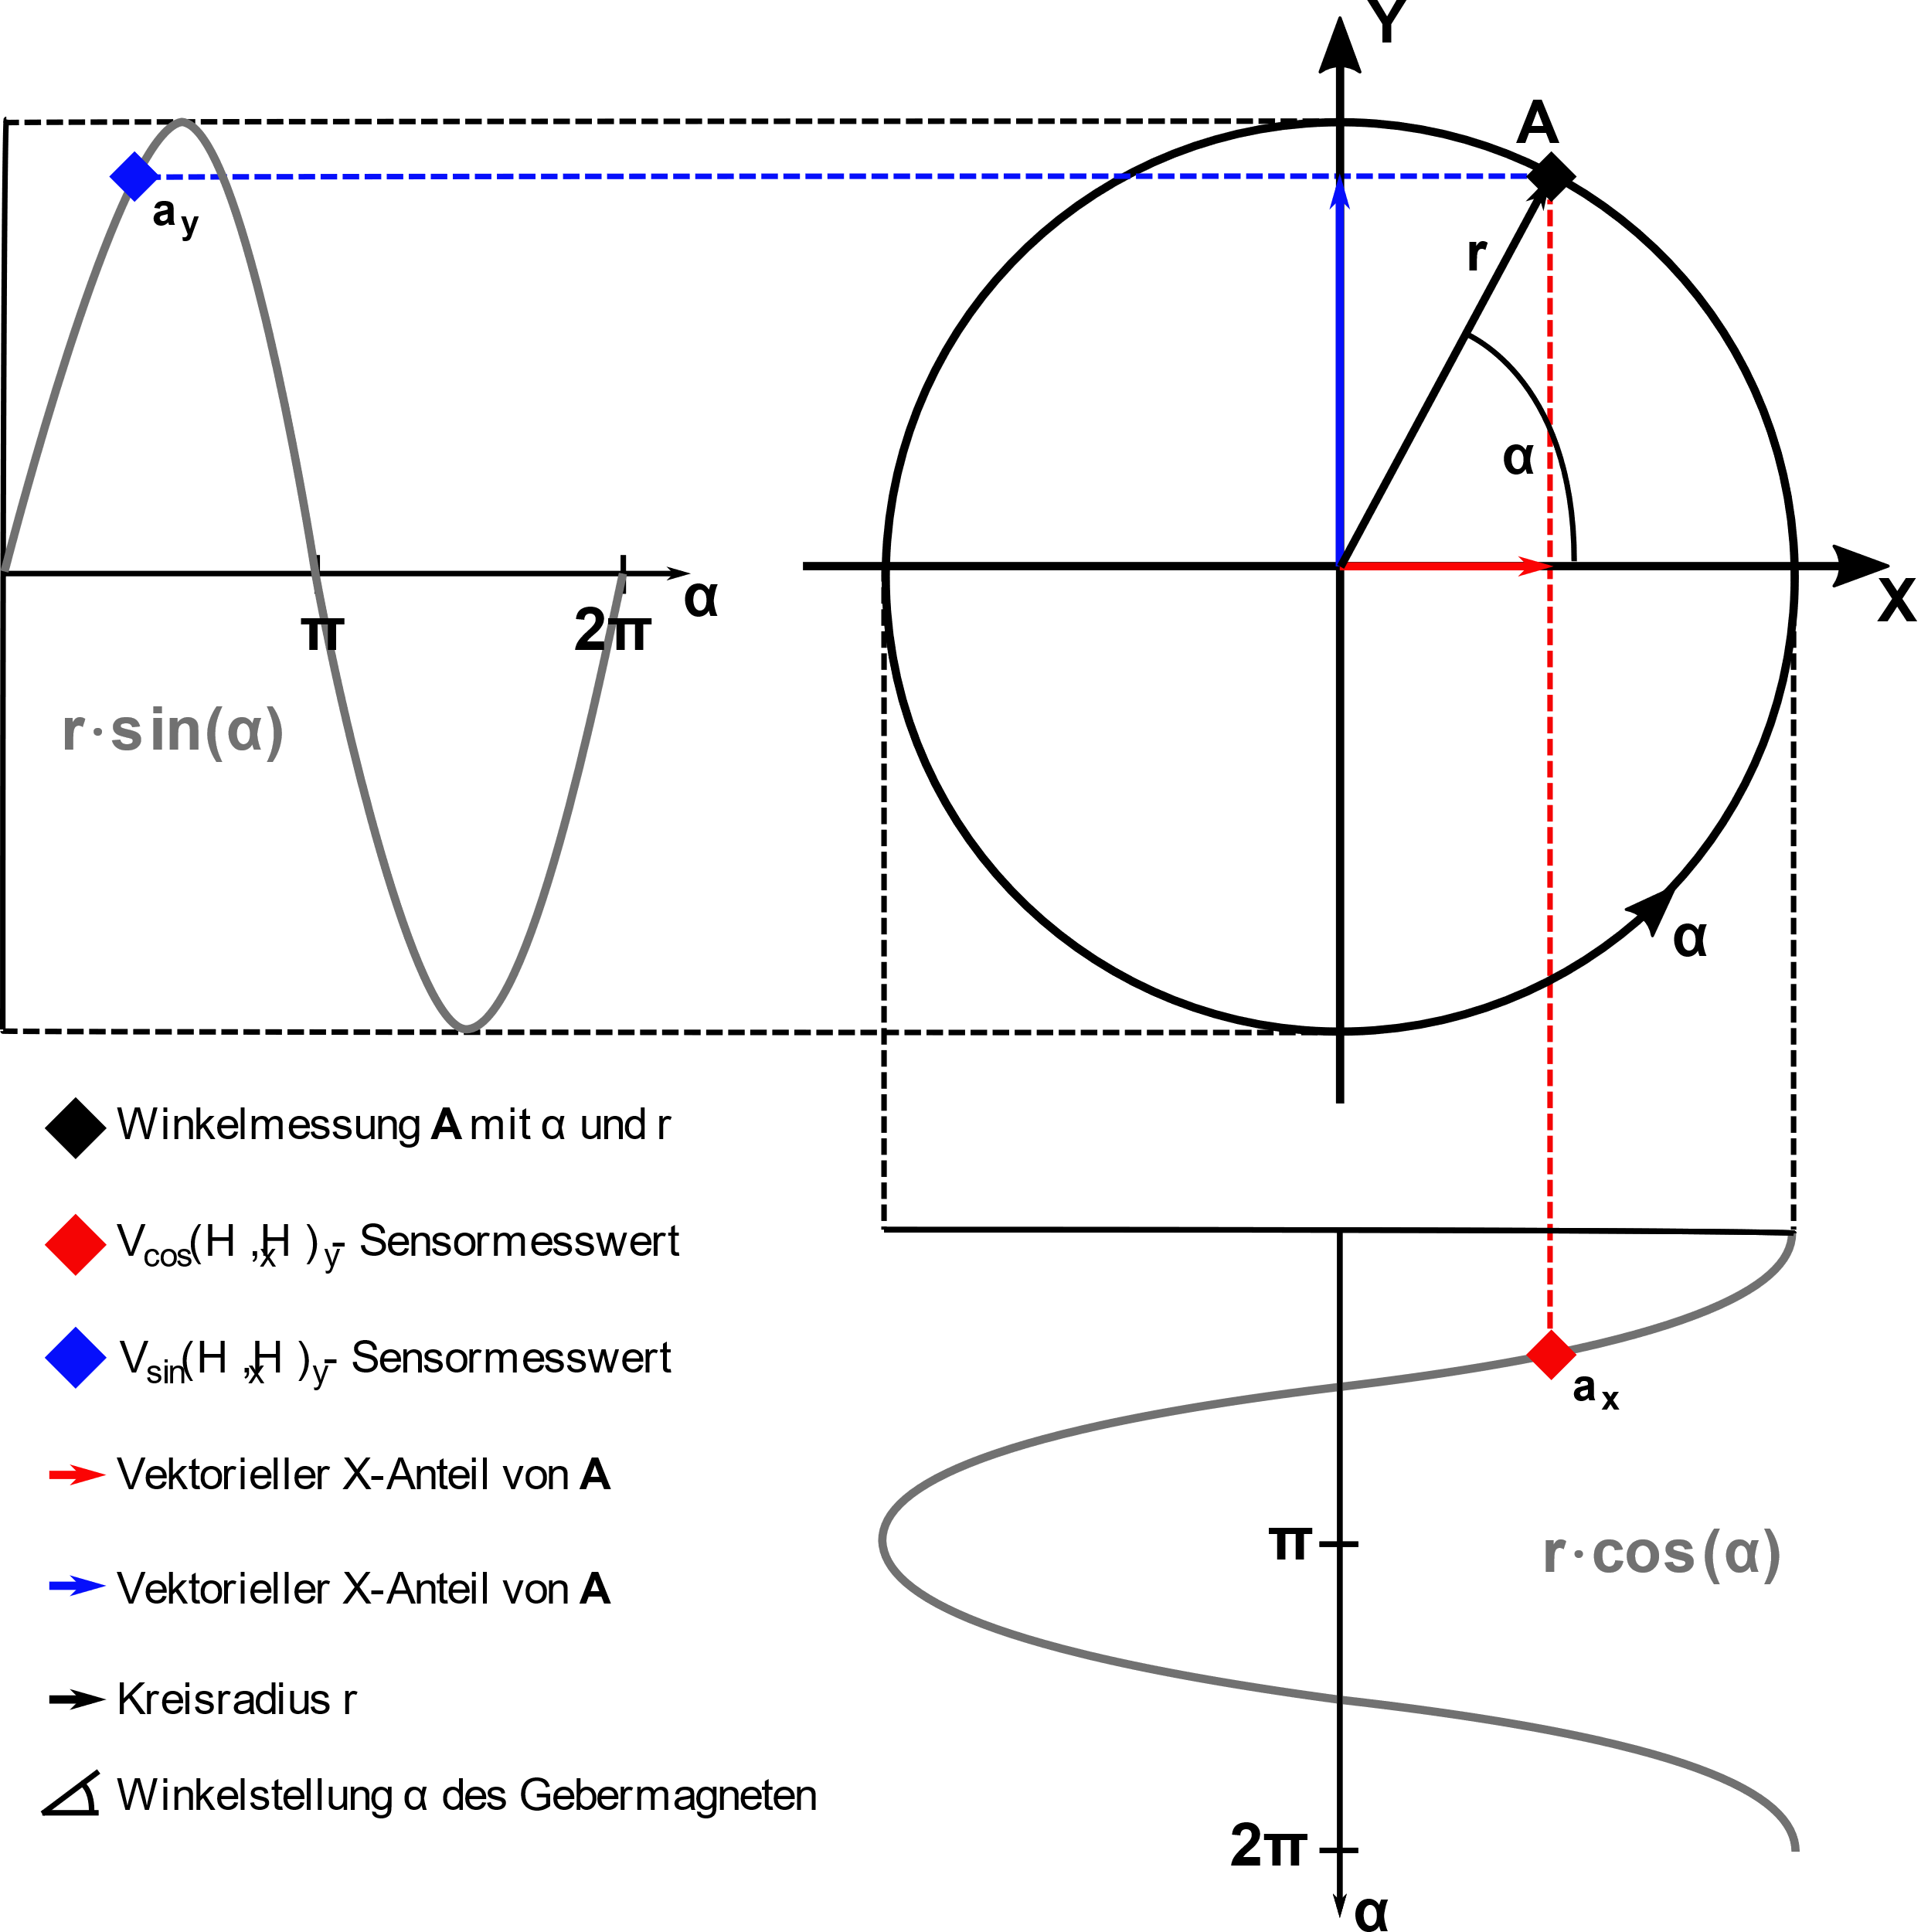
Application
Magnet Rotation
Encoder
Angular sensor

Slide 9
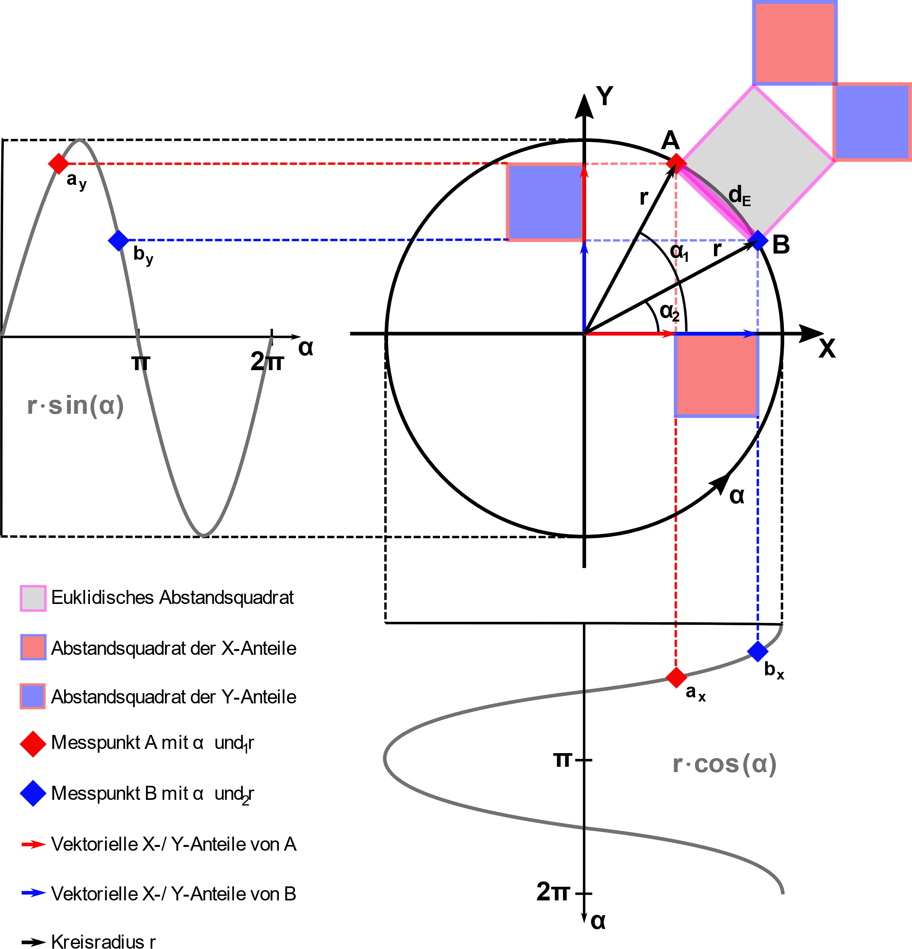
Application
Magnet Rotation
Encoder
Angular sensor

Slide 10
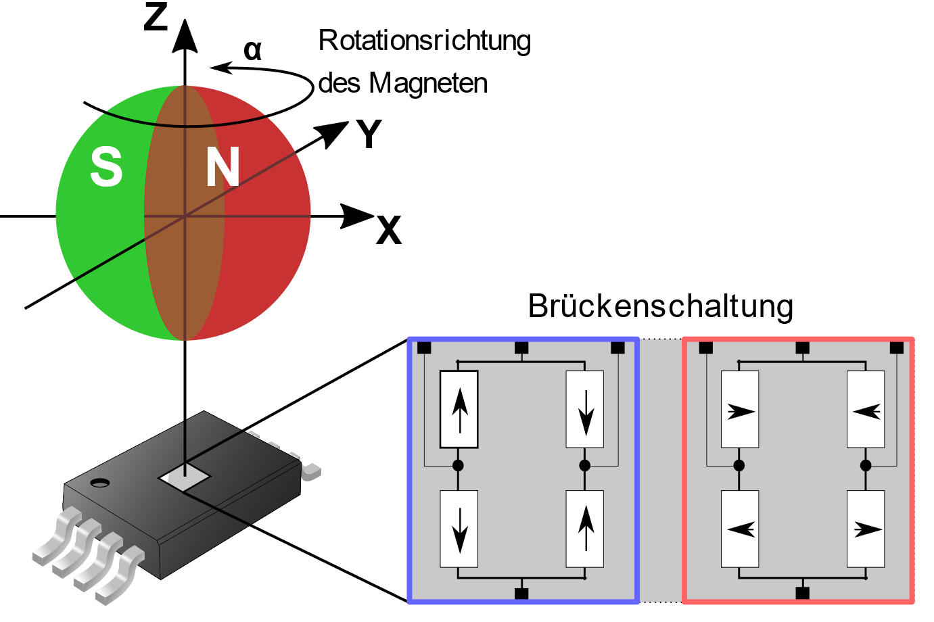
Application
Magnet Rotation
Bridge Circuit

Slide 11
Application
Magnet Rotation
TMR Sensor
Bridge Circuit

Slide 12
Application
Magnet Rotation
TMR Sensor
Wheatstone Bridge
Bridge Circuit
Sine
Cosine

Slide 13
Application
Magnet Rotation
TMR Sensor
Wheatstone Bridge
90° rotated to each other
360° periodicity
Bridge Circuit
Sine
Cosine

Slide 14
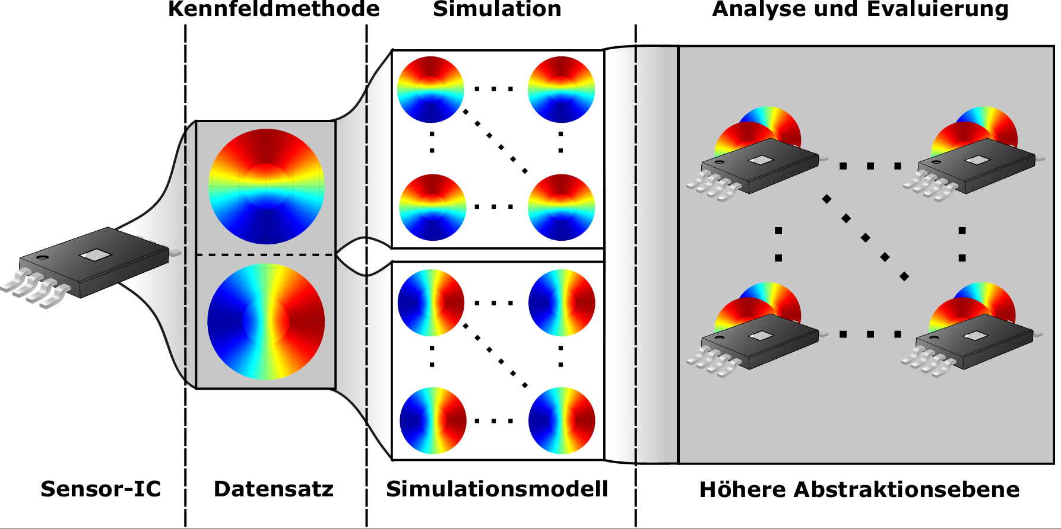
Characteristics
Characterization Method
Sensor
Dataset

Slide 15
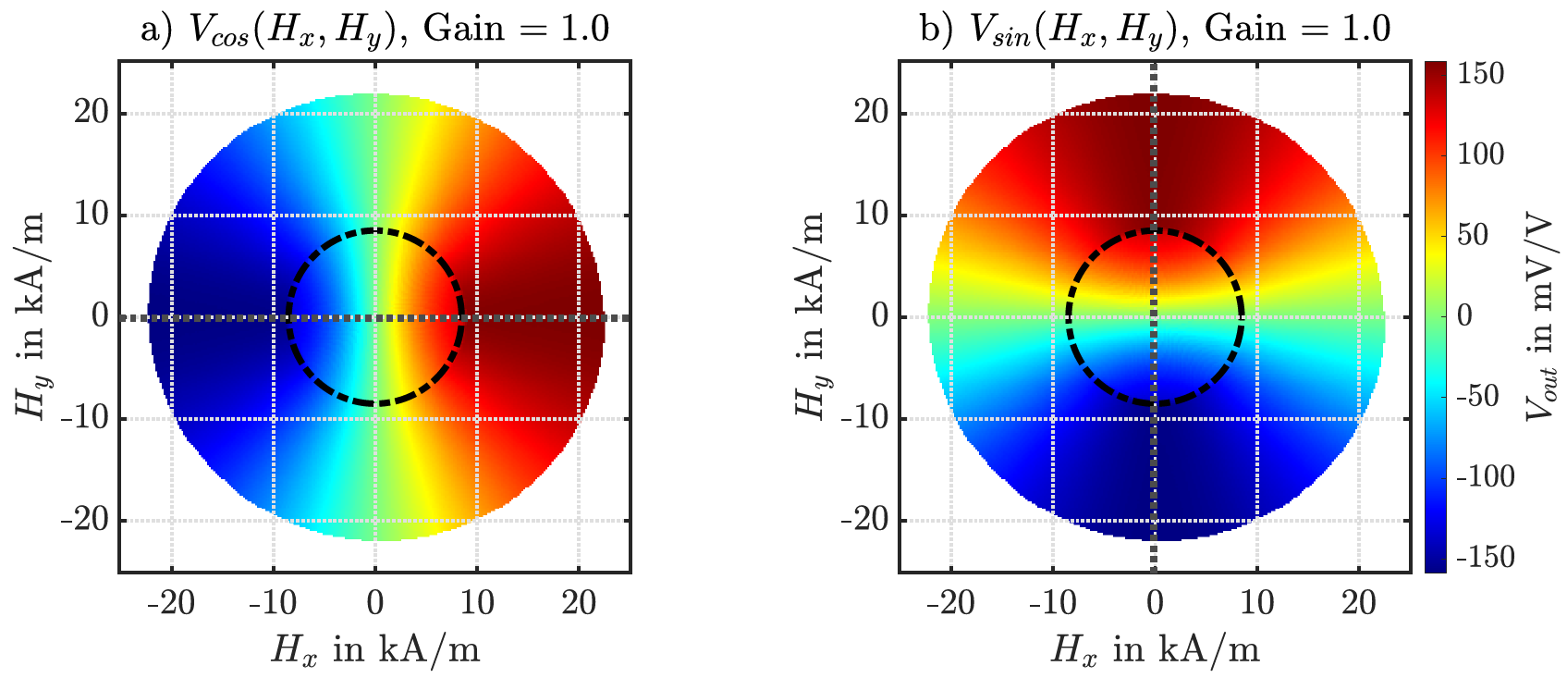
Characteristics
Characterization Method
360° periodicity
90° rotated
Sensor
Dataset

Slide 16
Characteristics
Characterization Method
360° periodicity
90° rotated
Linear plateaus
Sensor
Dataset

Slide 17
Characteristics
Characterization Method
360° periodicity
90° rotated
Linear plateaus
Transfer curves
Sensor
Dataset

Slide 18
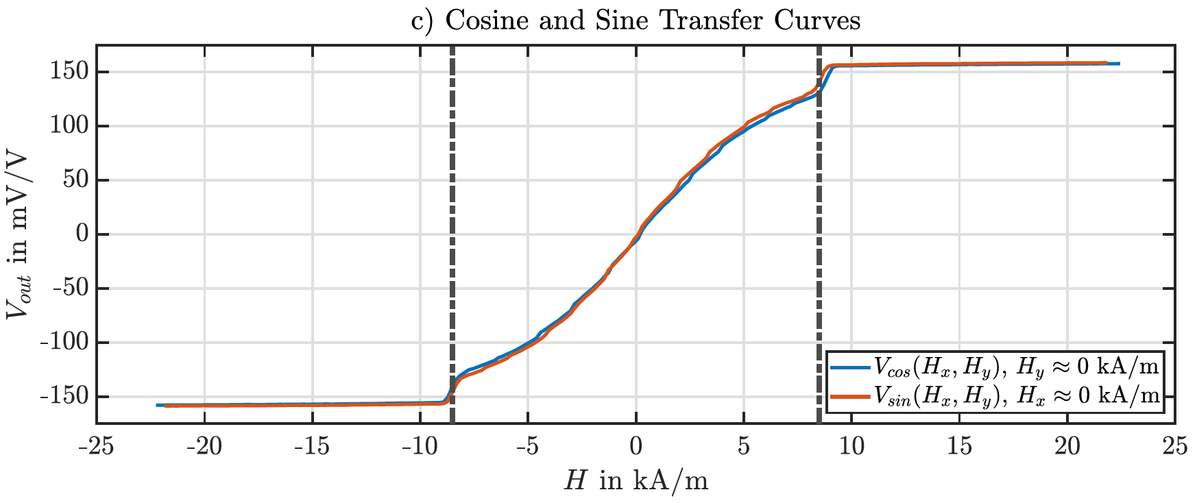
Characterization
Characterization Method
Transfer curves as slices
Sensor
Dataset

Slide 19
Characteristics
Characterization Method
Transfer curves as slices
Linear area
Sensor
Dataset

Slide 20
Characteristics
Characterization Method
Transfer curves as slices
Linear area
Saturation
Saturation
Sensor
Dataset

Slide 21
Characteristics
Characterization Method
Simulation
Sensor
Dataset
Simulation Model

Slide 22
Characteristics
Characterization Method
Simulation
Analyze and evaluate
Sensor
Dataset
Simulation Model
Higher abstraction level

Slide 23
Data Adaption

Slide 24
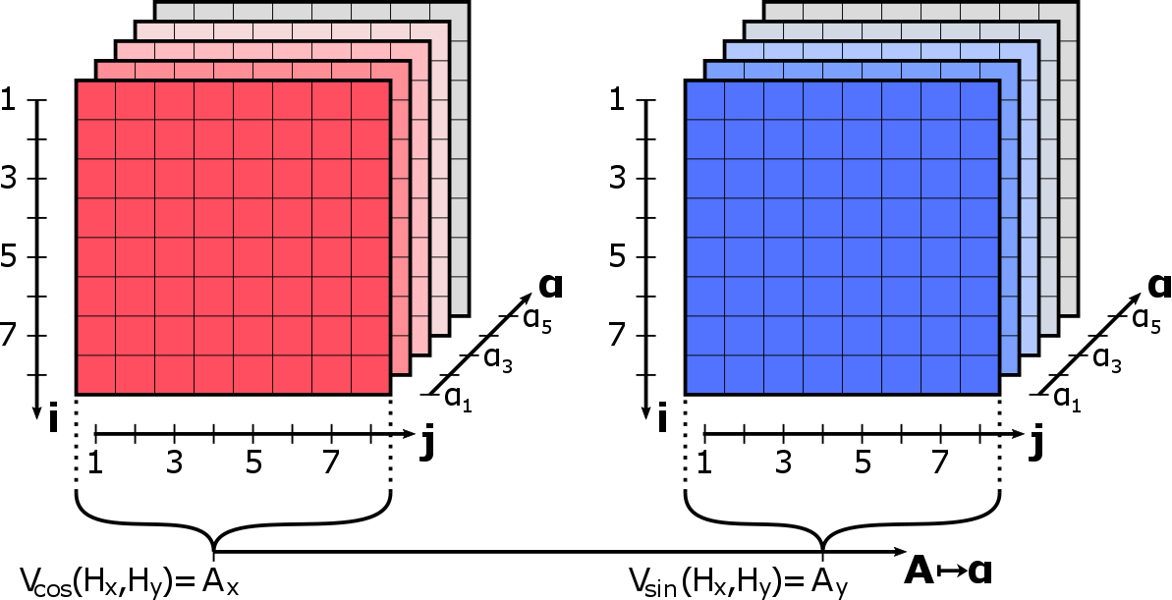
Data Adaption

Slide 25
Data Adaption

Slide 26
Data Adaption
Arrays as long vectors

Slide 27
Data Adaption
Arrays as long vectors
Frobenius-Norm

Slide 28
Gaussian Processes

Slide 29
Gaussian Processes
Learning by training data

Slide 30
Gaussian Processes
Learning by training data
Adjust by test data
Optimize by model parameter

Slide 31
Gaussian Processes
Learning by training data
Adjust by test data
Optimize by model parameter
Prediction by regression weights

Slide 32
Gaussian Processes
Learning by training data
Adjust by test data
Optimize by model parameter
Prediction by regression weights
Covariance function (Kernel) drives the model behavior!

Slide 33
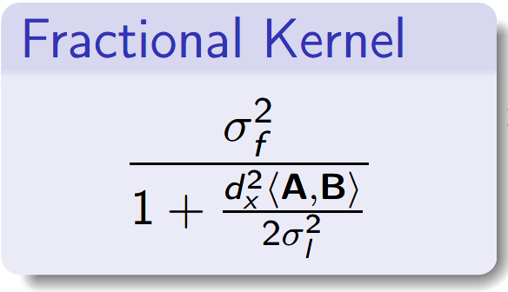
Gaussian Processes

Slide 34
Gaussian Processes
A
A
A
A
A

Slide 35
Gaussian Processes
B
A
B
B
A
A
B
A
A
B

Slide 36
Gaussian Processes
B
A
B
B
A
A
B
A
A
B

Slide 37
Gaussian Processes
B
A
B
B
A
A
B
A
A
B

Slide 38
Gaussian Processes
FORMAT
MEASURE
VALUE

Slide 39
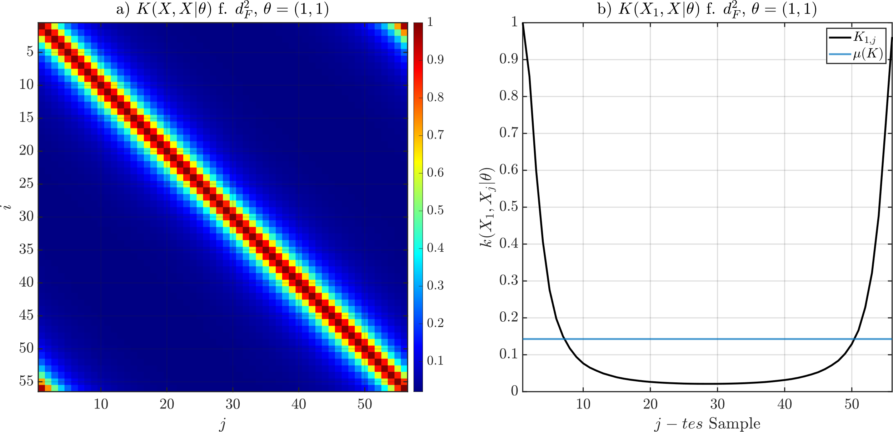
Gaussian Processes

Slide 40
Gaussian Processes
Dataset

Slide 41
Gaussian Processes
Dataset
360°
Periodicity

Slide 42
Gaussian Processes

Slide 43
Gaussian Processes

Slide 44
Gaussian Processes

Slide 45
Gaussian Processes
Scaling in dependency of training data

Slide 46
Gaussian Processes
Control of influence
Scaling in dependency of training data

Slide 47
Gaussian Processes
Control of influence
Data fit by model likelihoods
Scaling in dependency of training data

Slide 48
Gaussian Processes
Control of influence
Data fit by model likelihoods
Model generalization by losses
Scaling in dependency of training data

Slide 49
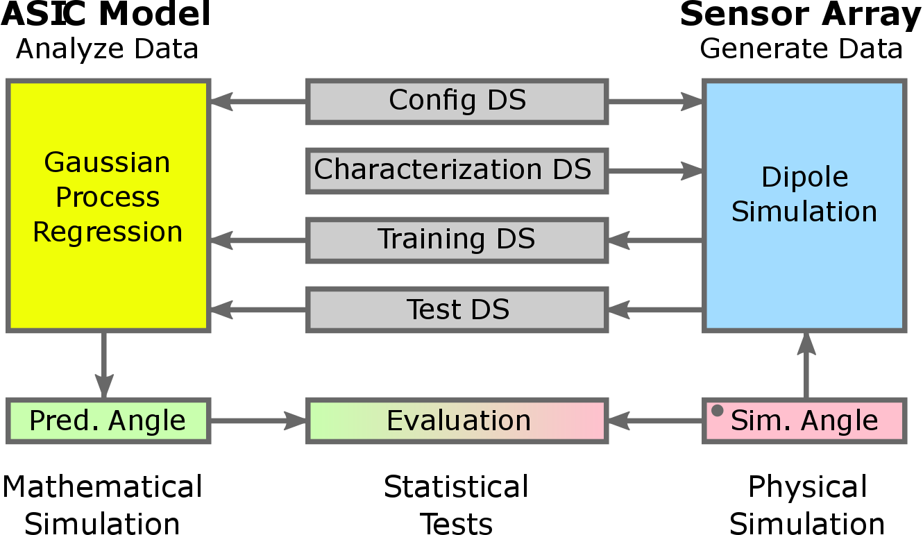
Software Development

Slide 50
Software Development

Slide 51
Software Development

Slide 52
Software Development

Slide 53
Software Development

Slide 54
Software Development

Slide 55
Software Development

Slide 56
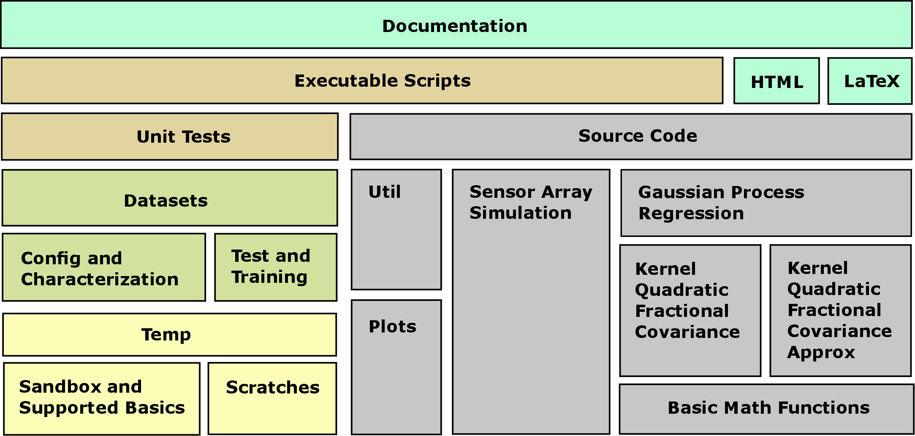
Software Development
Modul driven

Slide 57
Software Development
Modul driven
Reusability
Expandability

Slide 58
Software Development
Modul driven
Reusability
Expandability
Integration
Documentation

Slide 59
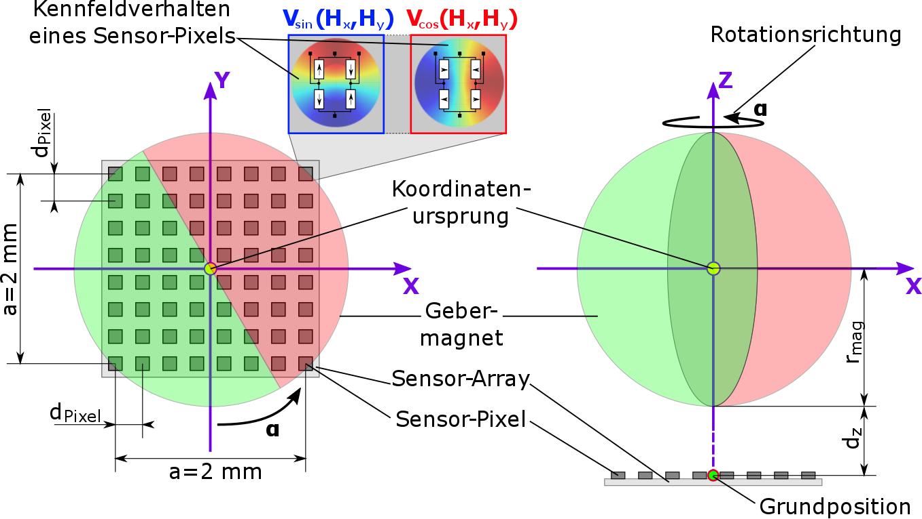
Simulation – Sensor Array
Characteristics of one Sensor Pixel
Rotation direction
Coordinate Center
Encoder
Sensor Array
Sensor Pixel
Root Position

Slide 60
Simulation – Sensor Array
Configuration of sizes, position, shape and voltage supply
Characteristics of one Sensor Pixel
Rotation direction
Coordinate Center
Encoder
Sensor Array
Sensor Pixel
Root Position

Slide 61
Simulation – Sensor Array
Configuration of sizes, position, shape and voltage supply
Determine start and rest position of the system
Characteristics of one Sensor Pixel
Rotation direction
Coordinate Center
Encoder
Sensor Array
Sensor Pixel
Root Position

Slide 62
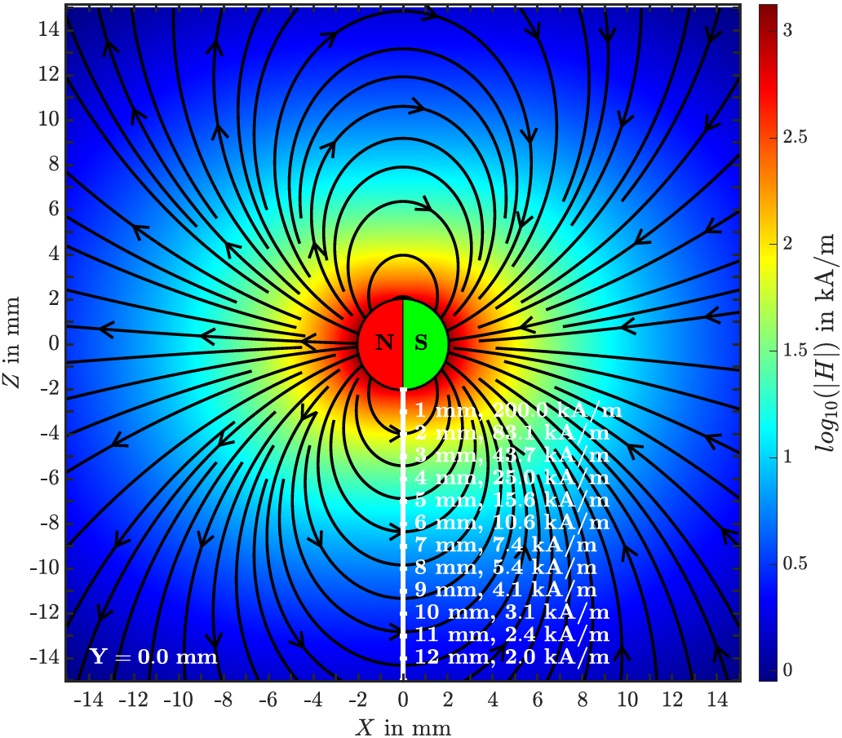
Simulation – Sensor Array

Slide 63
Simulation – Sensor Array
Imprinting configuration at 1 mm and 200 kA/m

Slide 64
Simulation – Sensor Array
Imprinting configuration at 1 mm and 200 kA/m
Minimal distance at 4 mm and 25 kA/m

Slide 65
Simulation – Sensor Array
Imprinting configuration at 1 mm and 200 kA/m
Minimal distance at 4 mm and 25 kA/m
Linear area at 7 mm and 7,4 kA/m

Slide 66
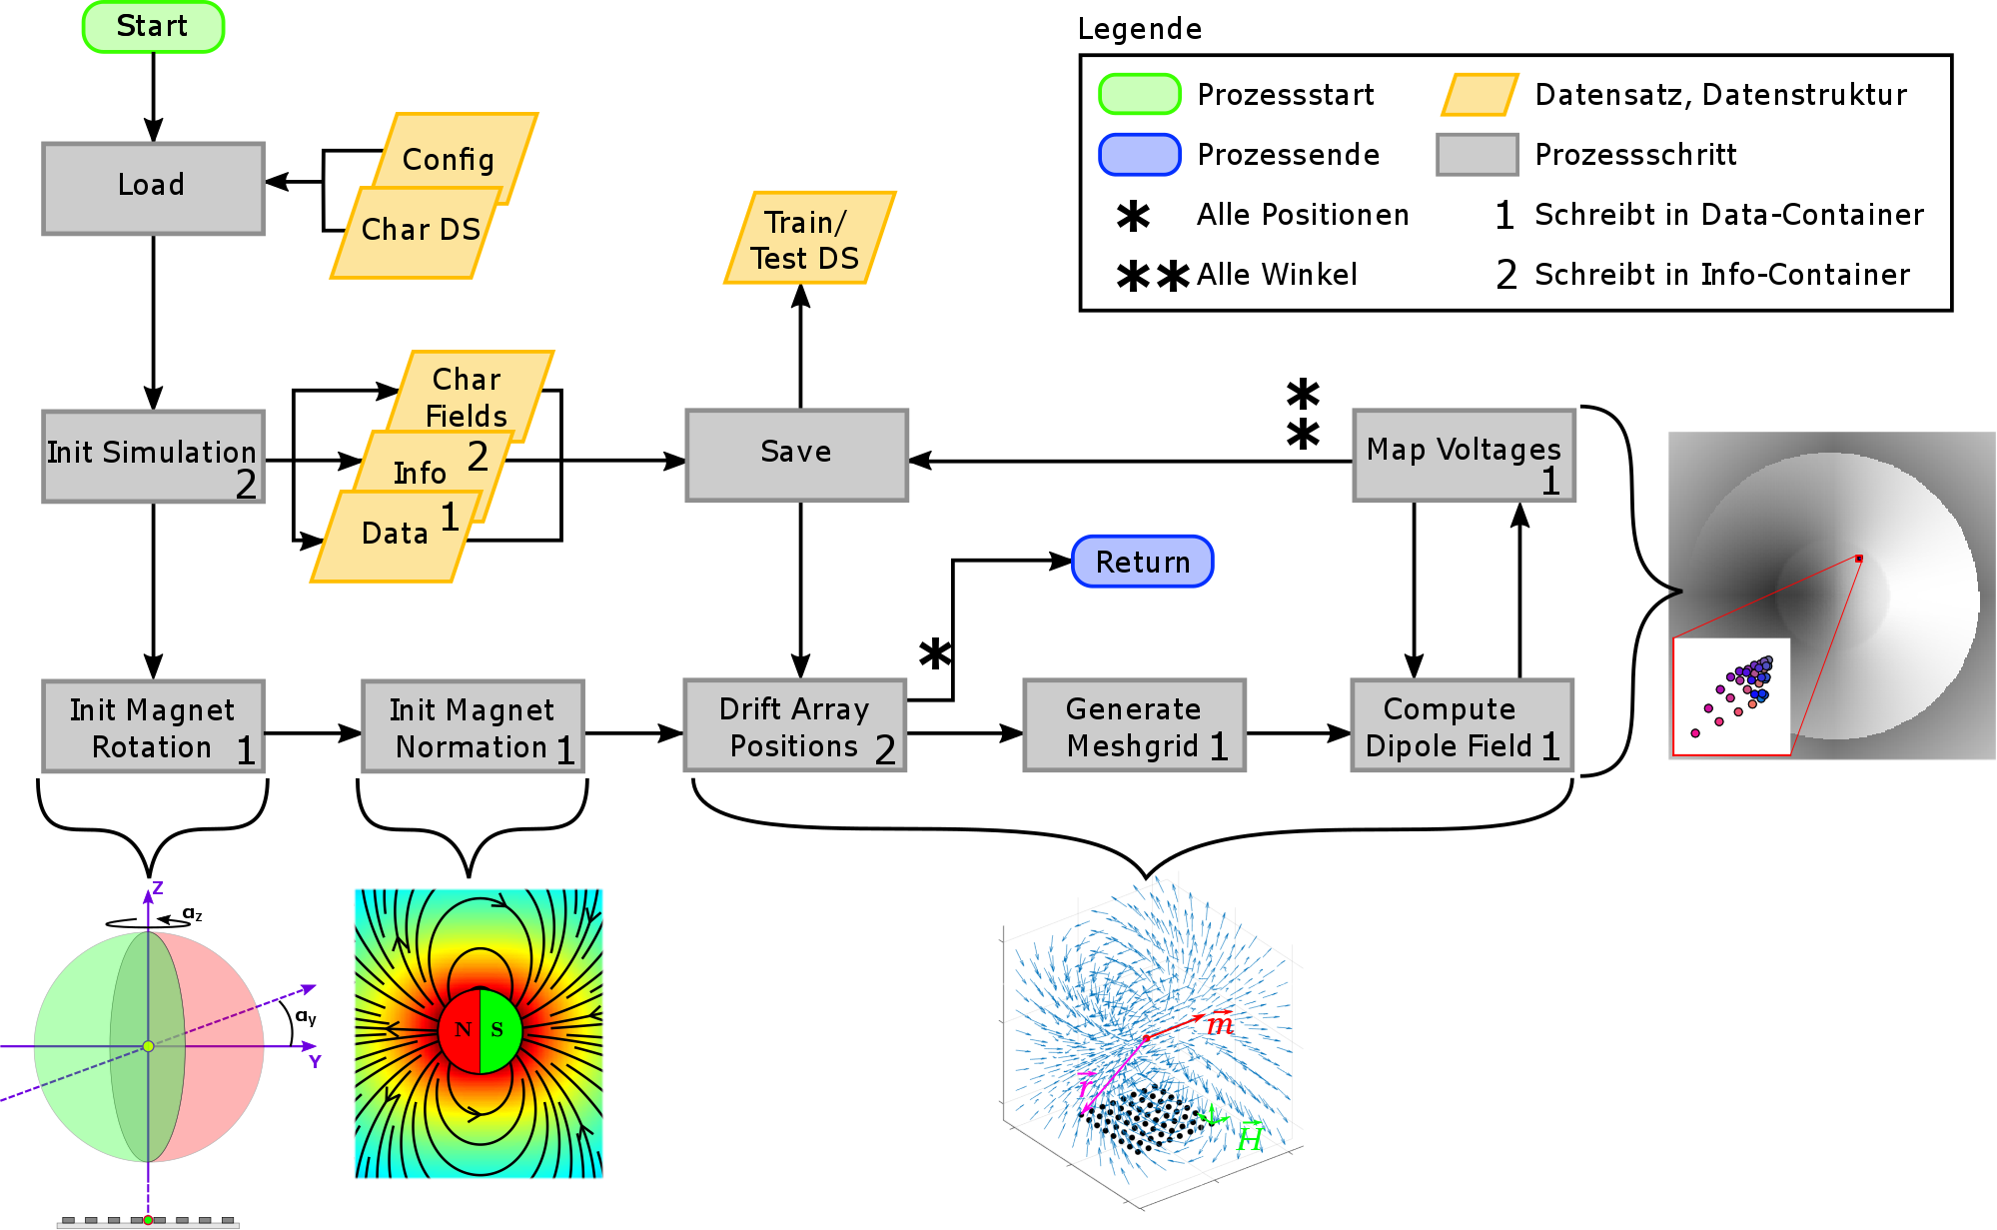
Simulation – Sensor Array

Slide 67
Simulation – Sensor Array
Load und initiate simulation parameters

Slide 68
Simulation – Sensor Array
Load und initiate simulation parameters
Execute in nested for loops

Slide 69
Simulation – Sensor Array
Load und initiate simulation parameters
Execute in nested for loops
Save data containers

Slide 70
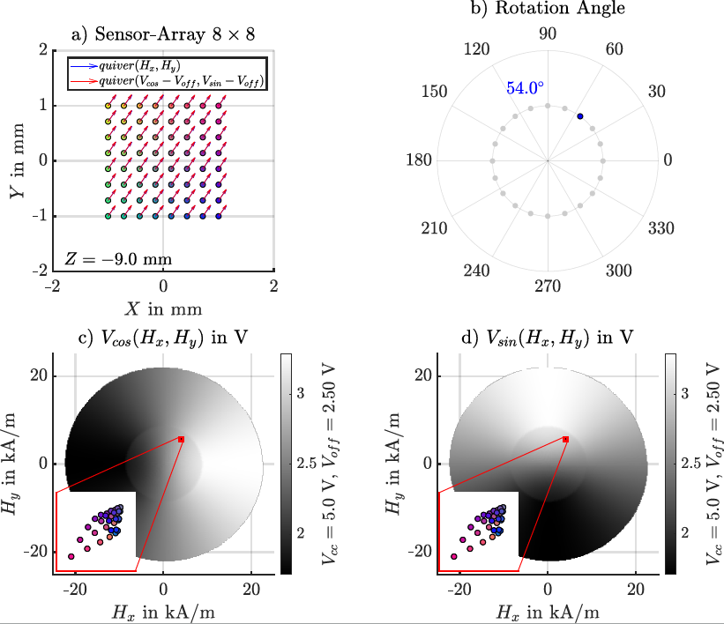
Simulation – Sensor Array

Slide 71
Simulation – Sensor Array
Input – simulation angle

Slide 72
Simulation – Sensor Array
Input – simulation angle
Mesh grid – calculation at each Sensor Pixel

Slide 73
Simulation – Sensor Array
Input – simulation angle
Mesh grid – calculation at each Sensor Pixel
Mapping – Take reference voltages

Slide 74
Sim. – Gaussian Processes
Configuration
MSLL – Mean Standardized Logarithmic Loss

Slide 75
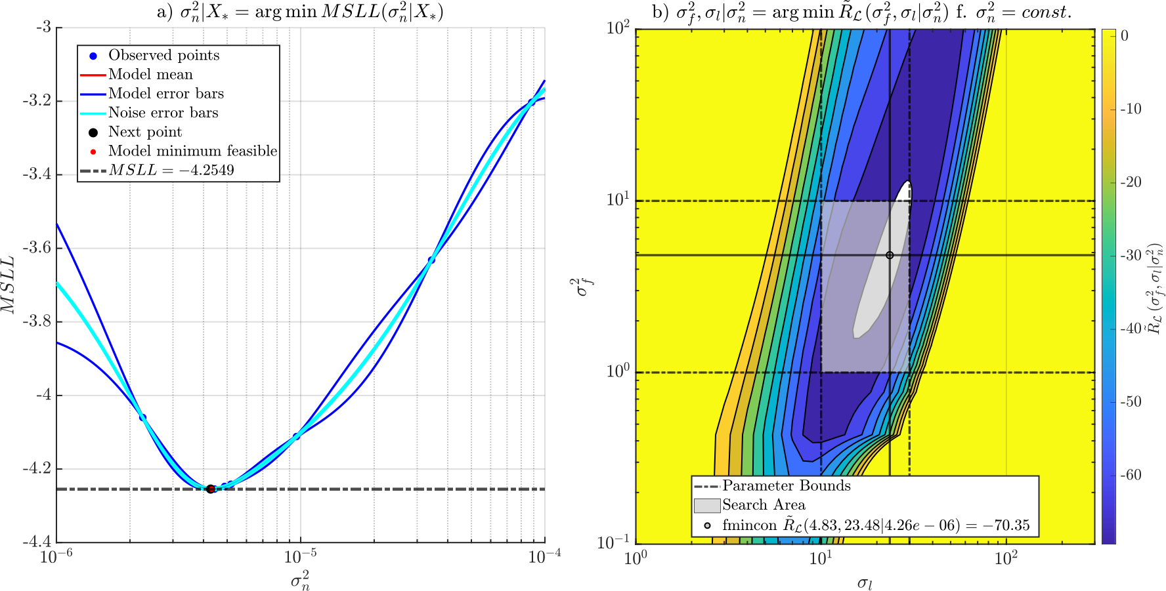
Sim. – Gaussian Processes
Generalization
Kernel Scaling
Configuration
Kernel Modul
Mean computation
MSLL – Mean Standardized Logarithmic Loss

Slide 76
Sim. – Gaussian Processes
Generalization
Kernel Scaling
Configuration
Kernel Modul
Mean computation
Loss computation
MSLL – Mean Standardized Logarithmic Loss

Slide 77
Sim. – Gaussian Processes
Generalization
Kernel Scaling
Configuration
Kernel Modul
Mean computation
Loss computation
Number of runs
MSLL – Mean Standardized Logarithmic Loss

Slide 78
Sim. – Gaussian Processes
Generalization
Kernel Scaling
Configuration
Kernel Modul
Mean computation
Loss computation
Number of runs
Parameter bounds
MSLL – Mean Standardized Logarithmic Loss

Slide 79
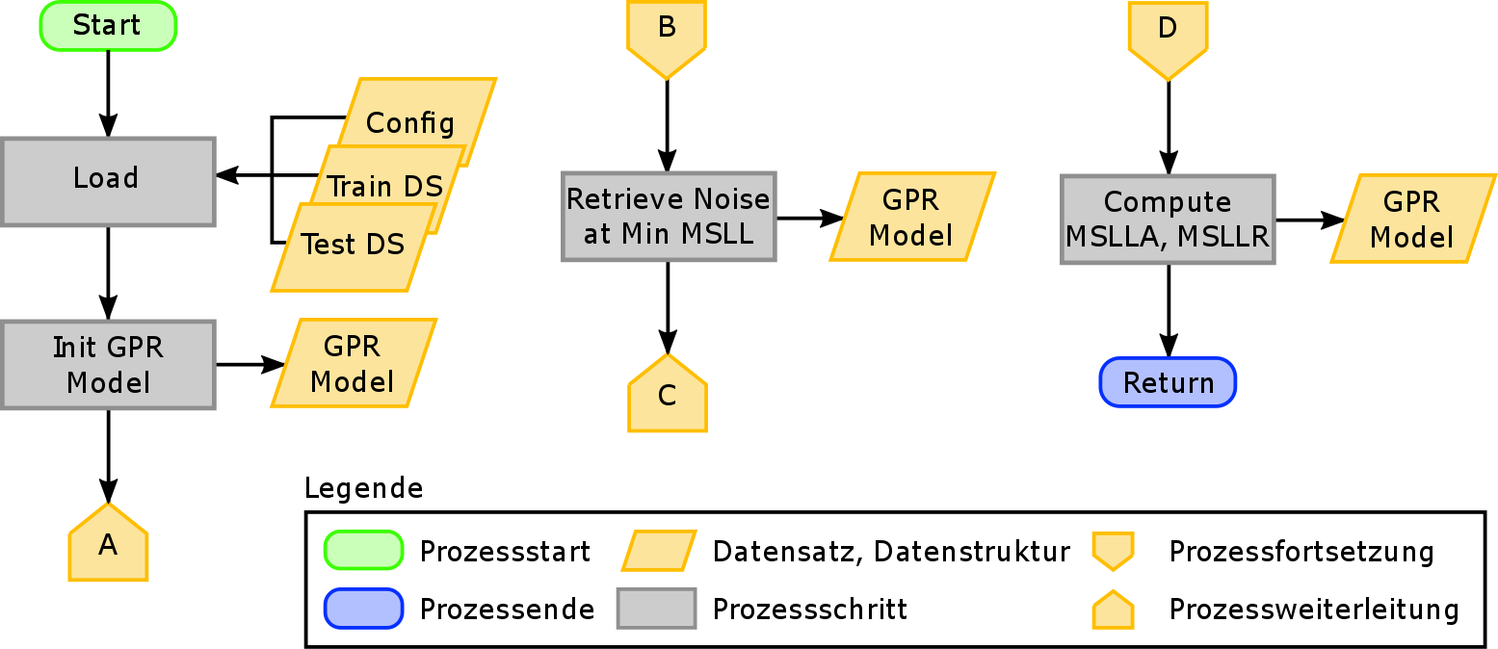
Sim. – Gaussian Processes
Training mode
GPR – Gaussian Processes for Regression
MSLL – Mean Standardized Logarithmic Loss
MSLLA – Mean Standardized Logarithmic Loss Angle
MSLLR – Mean Standardized Logarithmic Loss Radius

Slide 80
Sim. – Gaussian Processes
Training mode
Load and initiate
GPR – Gaussian Processes for Regression
MSLL – Mean Standardized Logarithmic Loss
MSLLA – Mean Standardized Logarithmic Loss Angle
MSLLR – Mean Standardized Logarithmic Loss Radius

Slide 81
Sim. – Gaussian Processes
Training mode
Load and initiate
Generalization with embedded scaling
GPR – Gaussian Processes for Regression
MSLL – Mean Standardized Logarithmic Loss
MSLLA – Mean Standardized Logarithmic Loss Angle
MSLLR – Mean Standardized Logarithmic Loss Radius

Slide 82
Sim. – Gaussian Processes
Training mode
Load and initiate
Generalization with embedded scaling
Final scaling and valuing
GPR – Gaussian Processes for Regression
MSLL – Mean Standardized Logarithmic Loss
MSLLA – Mean Standardized Logarithmic Loss Angle
MSLLR – Mean Standardized Logarithmic Loss Radius

Slide 83
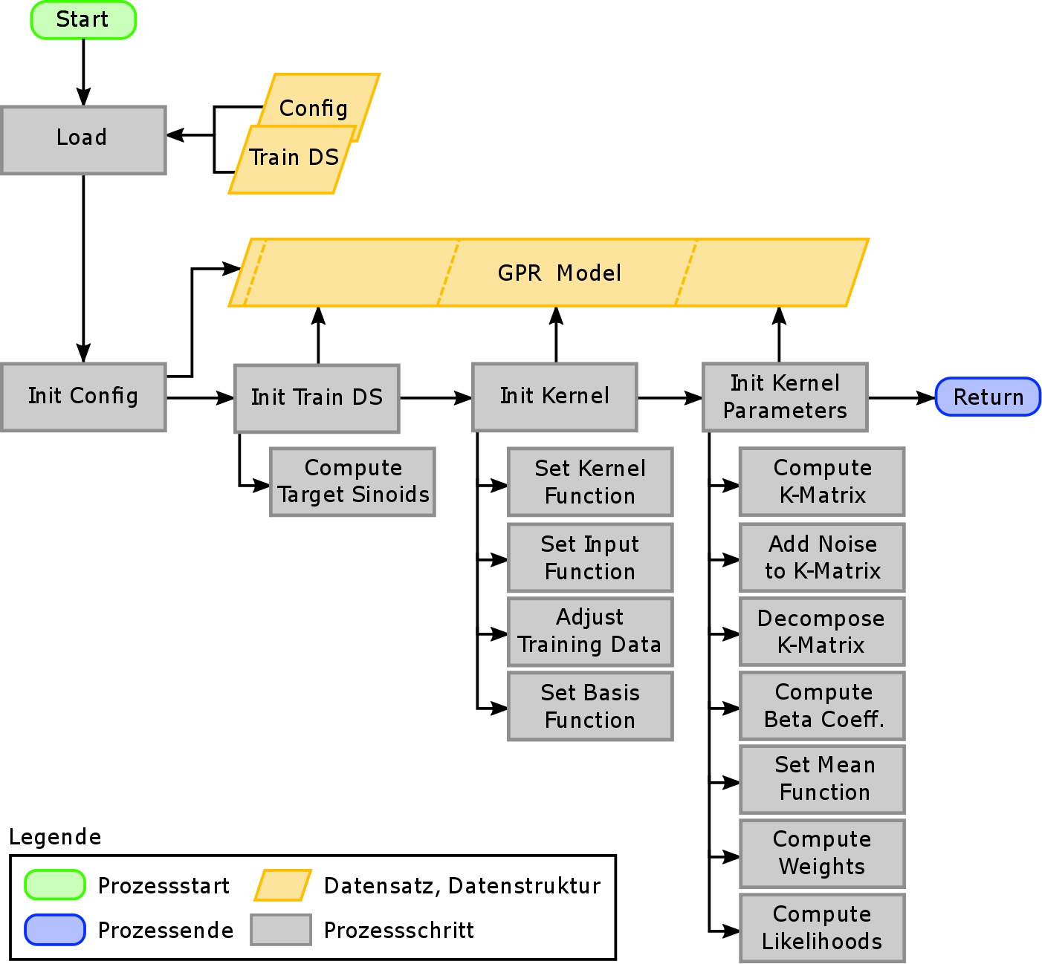
Sim. – Gaussian Processes
Sequential initialization
GPR – Gaussian Processes for Regression
DS – Dataset

Slide 84
Sim. – Gaussian Processes
Sequential initialization
Struct based model
GPR – Gaussian Processes for Regression
DS – Dataset

Slide 85
Sim. – Gaussian Processes
Sequential initialization
Struct based model
Framework configuration
GPR – Gaussian Processes for Regression
DS – Dataset

Slide 86
Sim. – Gaussian Processes
Sequential initialization
Struct based model
Framework configuration
Build up references
GPR – Gaussian Processes for Regression
DS – Dataset

Slide 87
Sim. – Gaussian Processes
Sequential initialization
Struct based model
Framework configuration
Build up references
Load functionality
GPR – Gaussian Processes for Regression
DS – Dataset

Slide 88
Sim. – Gaussian Processes
Sequential initialization
Struct based model
Framework configuration
Build up references
Load functionality
Parametrize model
GPR – Gaussian Processes for Regression
DS – Dataset

Slide 89
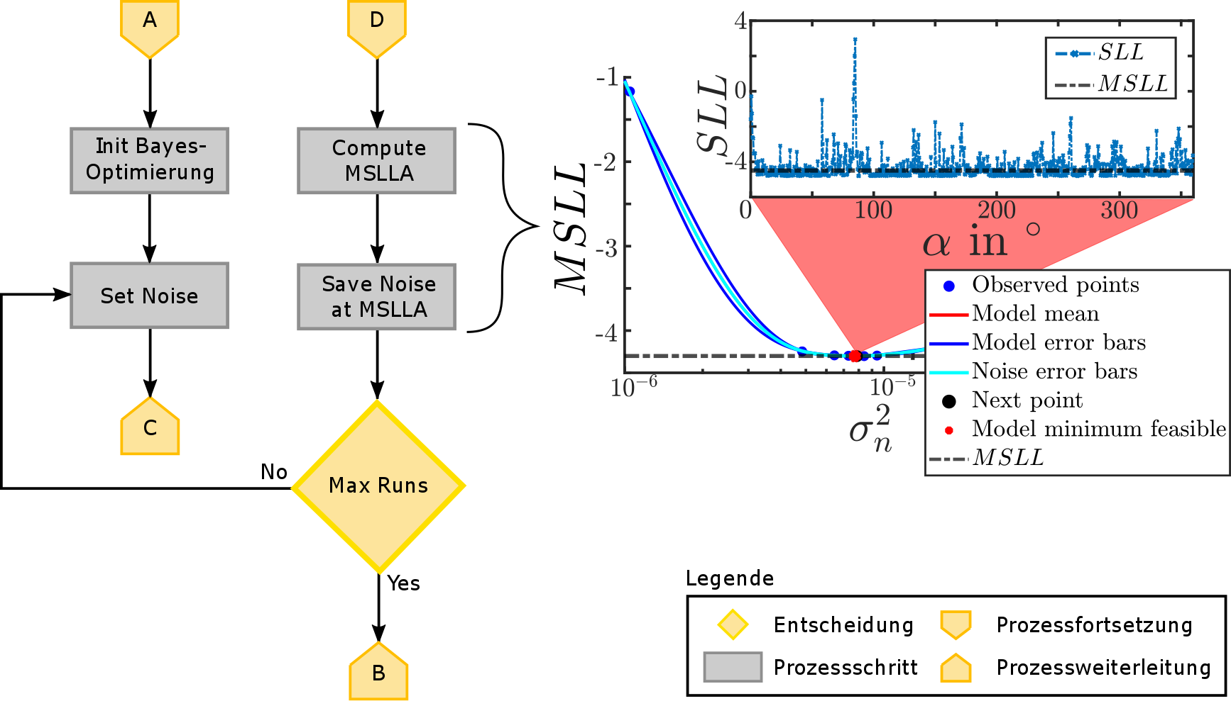
Sim. – Gaussian Processes
Generalization
SLL – Standardized Logarithmic Loss
MSLL – Mean Standardized Logarithmic Loss
MSLLA – Mean Standardized Logarithmic Loss Angle

Slide 90
Sim. – Gaussian Processes
Generalization
Set Noise Variance
SLL – Standardized Logarithmic Loss
MSLL – Mean Standardized Logarithmic Loss
MSLLA – Mean Standardized Logarithmic Loss Angle

Slide 91
Sim. – Gaussian Processes
Generalization
Set Noise Variance
Kernel scaling
SLL – Standardized Logarithmic Loss
MSLL – Mean Standardized Logarithmic Loss
MSLLA – Mean Standardized Logarithmic Loss Angle

Slide 92
Sim. – Gaussian Processes
Generalization
Set Noise Variance
Kernel scaling
Loss computation
SLL – Standardized Logarithmic Loss
MSLL – Mean Standardized Logarithmic Loss
MSLLA – Mean Standardized Logarithmic Loss Angle

Slide 93
Sim. – Gaussian Processes
Generalization
Set Noise Variance
Kernel scaling
Loss computation
Save intermediate results
SLL – Standardized Logarithmic Loss
MSLL – Mean Standardized Logarithmic Loss
MSLLA – Mean Standardized Logarithmic Loss Angle

Slide 94
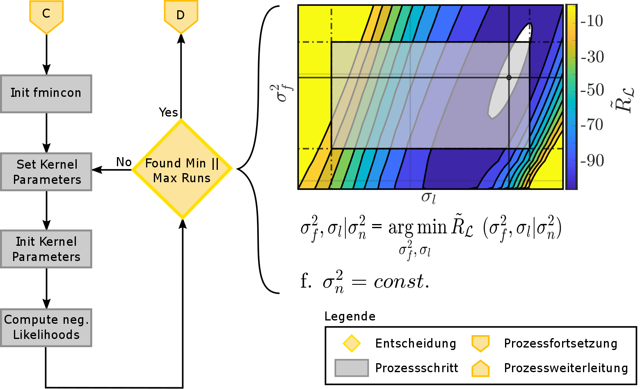
Sim. – Gaussian Processes
Kernel Scaling

Slide 95
Sim. – Gaussian Processes
Kernel Scaling
Set kernel parameter

Slide 96
Sim. – Gaussian Processes
Kernel Scaling
Set kernel parameter
Partial reinitialization

Slide 97
Sim. – Gaussian Processes
Kernel Scaling
Set kernel parameter
Partial reinitialization
Likelihood computation

Slide 98
Sim. – Gaussian Processes
Working mode

Slide 99
Sim. – Gaussian Processes
Working mode
Switch model direction from fitting to prediction

Slide 100
Sim. – Gaussian Processes
Working mode
Switch model direction from fitting to prediction
Minimized parameter set and functional driver for prediction

Slide 101
Sim. – Gaussian Processes
Working mode
Switch model direction from fitting to prediction
Minimized parameter set and functional driver for prediction
Framewise or block wise prediction

Slide 102
Sim. – Gaussian Processes
Working mode
Switch model direction from fitting to prediction
Minimized parameter set and functional driver for prediction
Framewise or block wise prediction
Results, derivates and quality measures return as vectors

Slide 103
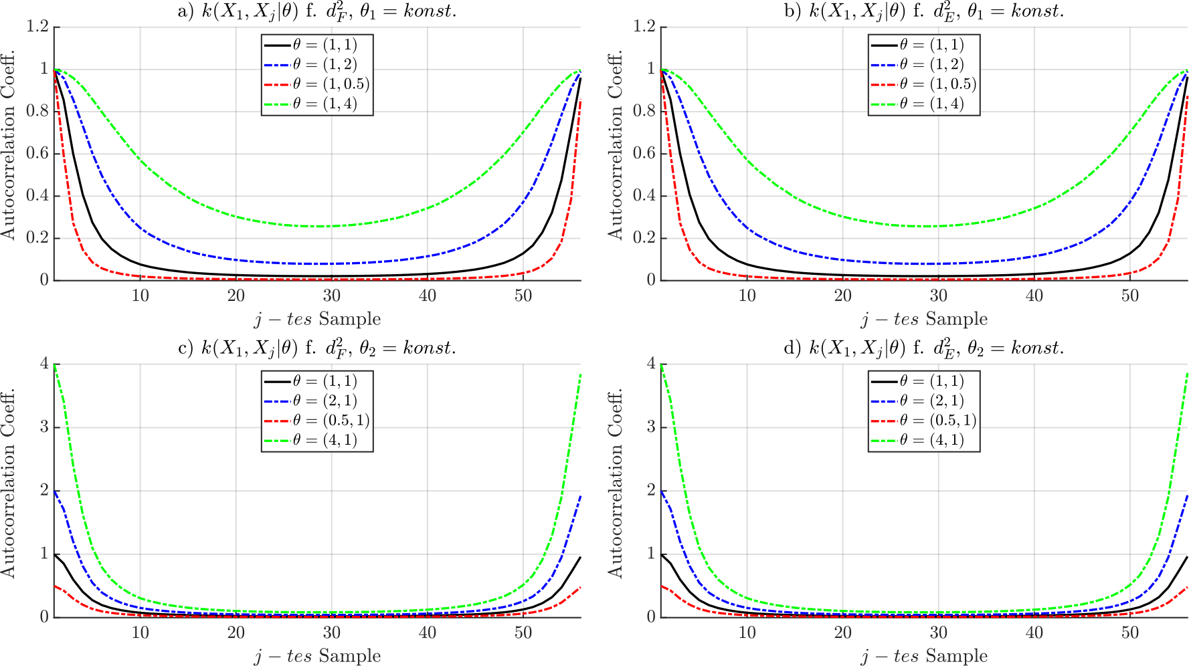
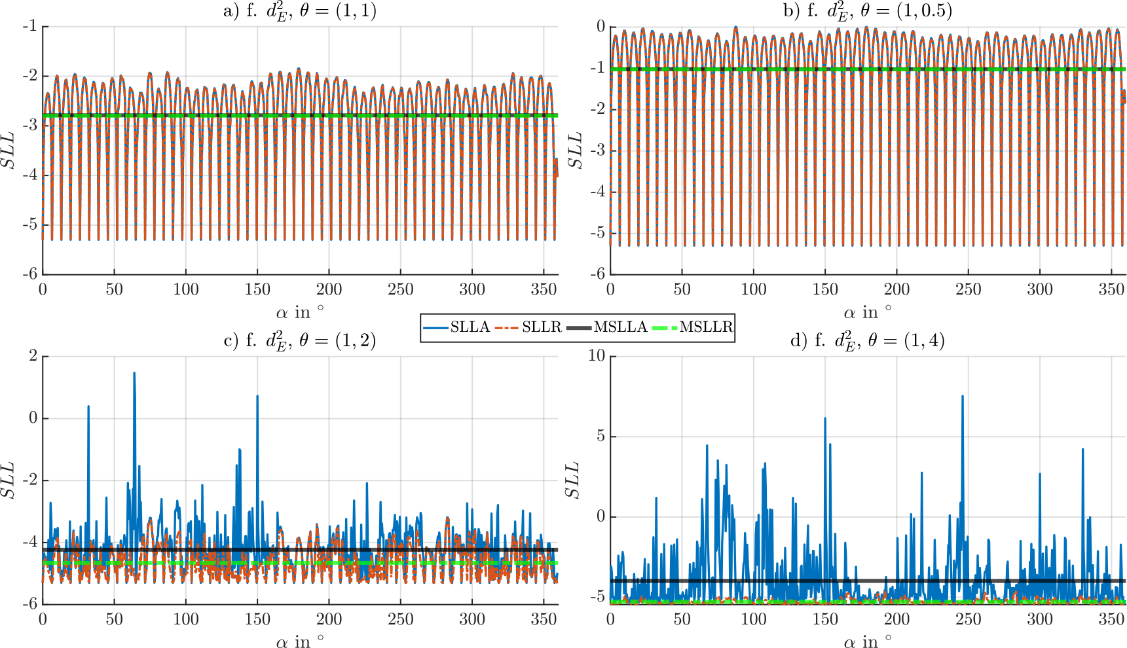
Testing Experiments
Scaling of covariance function
SLLA – Standardized Logarithmic Loss Angle
SLLR – Standardized Logarithmic Loss Radius
MSLLA – Mean Standardized Logarithmic Loss Angle
MSLLR – Mean Standardized Logarithmic Loss Radius

Slide 104
Testing Experiments
Scaling of covariance function
Empirical without optimization
SLLA – Standardized Logarithmic Loss Angle
SLLR – Standardized Logarithmic Loss Radius
MSLLA – Mean Standardized Logarithmic Loss Angle
MSLLR – Mean Standardized Logarithmic Loss Radius

Slide 105
Testing Experiments
Scaling of covariance function
Empirical without optimization
Value the generalization
Disabled
SLLA – Standardized Logarithmic Loss Angle
SLLR – Standardized Logarithmic Loss Radius
MSLLA – Mean Standardized Logarithmic Loss Angle
MSLLR – Mean Standardized Logarithmic Loss Radius

Slide 106
Testing Experiments
Scaling of covariance function
Empirical without optimization
Value the generalization
Disabled
SLLA – Standardized Logarithmic Loss Angle
SLLR – Standardized Logarithmic Loss Radius
MSLLA – Mean Standardized Logarithmic Loss Angle
MSLLR – Mean Standardized Logarithmic Loss Radius

Slide 107
Testing Experiments
Scaling of covariance function
Empirical without optimization
Value the generalization
Overfitting
SLLA – Standardized Logarithmic Loss Angle
SLLR – Standardized Logarithmic Loss Radius
MSLLA – Mean Standardized Logarithmic Loss Angle
MSLLR – Mean Standardized Logarithmic Loss Radius

Slide 108
Testing Experiments
Scaling of covariance function
Empirical without optimization
Value the generalization
Improved
SLLA – Standardized Logarithmic Loss Angle
SLLR – Standardized Logarithmic Loss Radius
MSLLA – Mean Standardized Logarithmic Loss Angle
MSLLR – Mean Standardized Logarithmic Loss Radius

Slide 109
Testing Experiments
Scaling of covariance function
Empirical without optimization
Value the generalization
Improved
Attention
SLLA – Standardized Logarithmic Loss Angle
SLLR – Standardized Logarithmic Loss Radius
MSLLA – Mean Standardized Logarithmic Loss Angle
MSLLR – Mean Standardized Logarithmic Loss Radius

Slide 110
Testing Experiments
Scaling of covariance function
Empirical without optimization
Value the generalization
Optimizable
SLLA – Standardized Logarithmic Loss Angle
SLLR – Standardized Logarithmic Loss Radius
MSLLA – Mean Standardized Logarithmic Loss Angle
MSLLR – Mean Standardized Logarithmic Loss Radius

Slide 111
Testing Experiments
Scaling of covariance function
Empirical without optimization
Value the generalization
Optimizable
Critical area
SLLA – Standardized Logarithmic Loss Angle
SLLR – Standardized Logarithmic Loss Radius
MSLLA – Mean Standardized Logarithmic Loss Angle
MSLLR – Mean Standardized Logarithmic Loss Radius

Slide 112
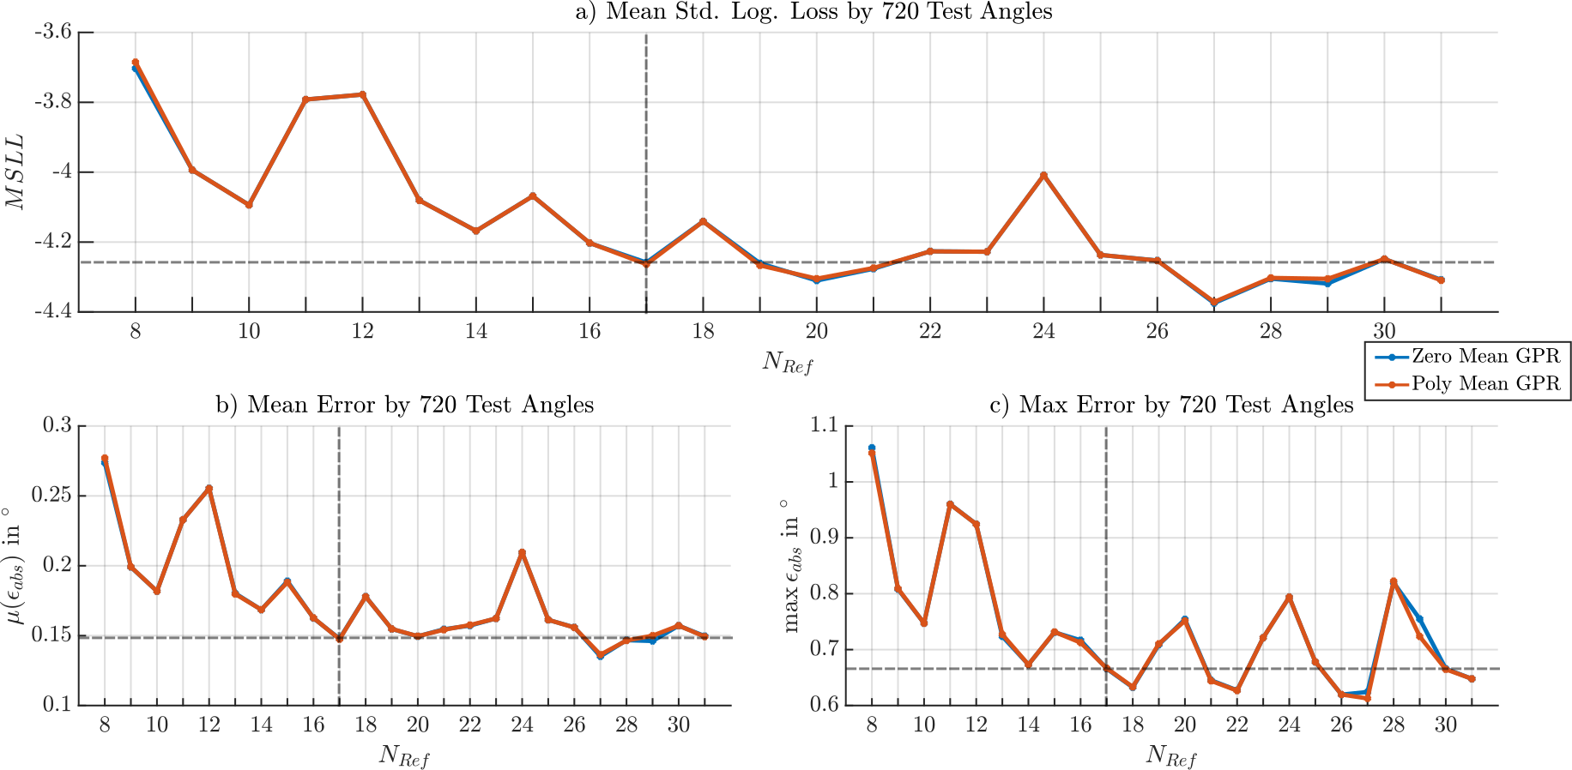
Testing Experiments
Trade-off
MSLL – Mean-Standardized-Logarithmic-Loss

Slide 113
Testing Experiments
Trade-off
Switch on optimization
MSLL – Mean-Standardized-Logarithmic-Loss

Slide 114
Testing Experiments
Trade-off
Switch on optimization
Resources
Effort
MSLL – Mean-Standardized-Logarithmic-Loss

Slide 115
Testing Experiments
Trade-off
Switch on optimization
Resources
Effort
MSLL – Mean-Standardized-Logarithmic-Loss

Slide 116
Testing Experiments
Trade-off
Switch on optimization
Resources
Effort
Balancing error and loss
MSLL – Mean-Standardized-Logarithmic-Loss

Slide 117
Testing Experiments
17 Reference angles
Trade-off
Switch on optimization
Resources
Effort
Balancing error and loss
MSLL – Mean-Standardized-Logarithmic-Loss

Slide 118
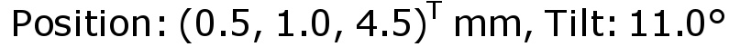
Testing Experiments

Slide 119
Testing Experiments
Drifted in X-/ Y-direction
Small distance
Tilt magnet

Slide 120
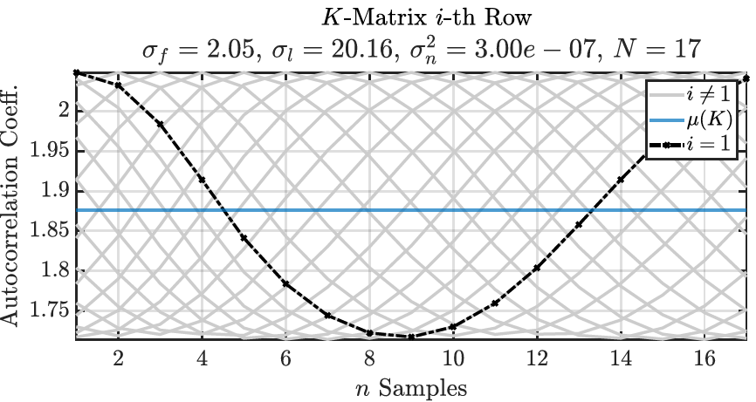
Testing Experiments
Drifted in X-/ Y-direction
Small distance
Tilt magnet

Slide 121
Testing Experiments
Drifted in X-/ Y-direction
Small distance
Tilt magnet
Balancing references

Slide 122
Testing Experiments
Drifted in X-/ Y-direction
Small distance
Tilt magnet
Balancing references
Scaling ration nearby 1:10
Good preconditions

Slide 123
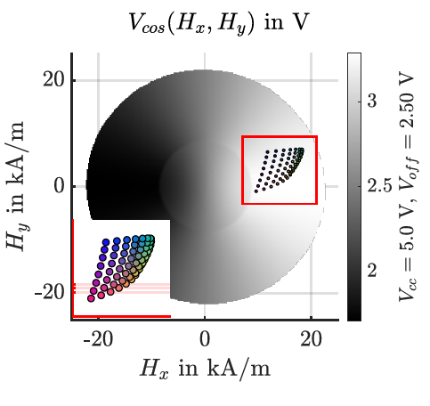
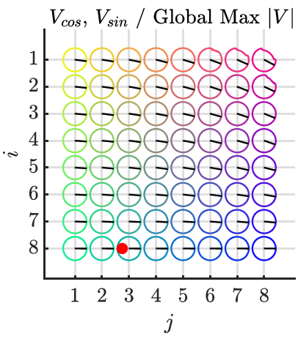
Testing Experiments

Slide 124
Testing Experiments
Magnet at array edge

Slide 125
Testing Experiments
Saturation + Dispersion
Magnet at array edge

Slide 126
Testing Experiments
Saturation + Dispersion
Misaligned angles
Magnet at array edge

Slide 127
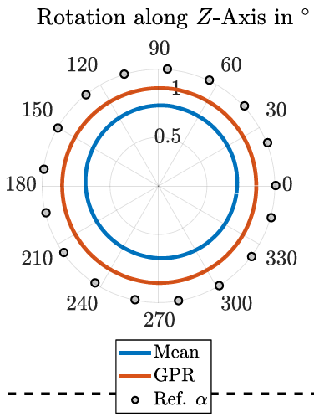
Testing Experiments

Slide 128
Testing Experiments
Simple mean is drifted

Slide 129
Testing Experiments
Simple mean is drifted
Regression balanced out

Slide 130
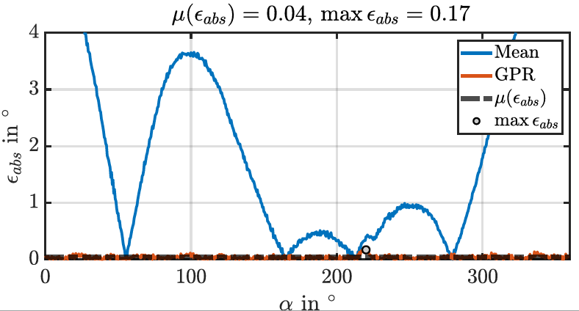
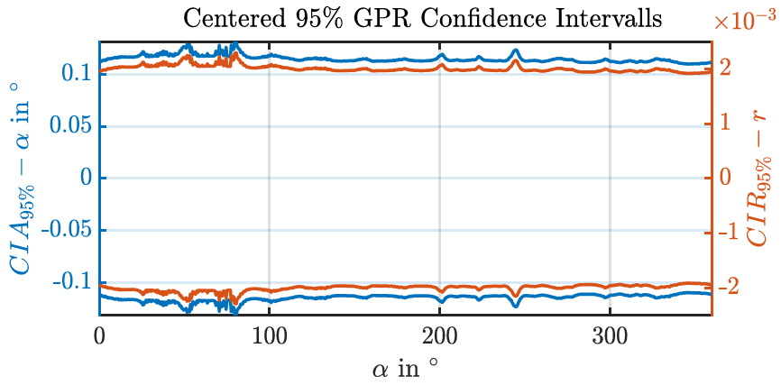
Testing Experiments

Slide 131
Testing Experiments
Very small angle errors over full rotation

Slide 132
Testing Experiments
Very small angle errors over full rotation
Small variation

Slide 133
Testing Experiments
Very small angle errors over full rotation
Small lift, leak of coverage
Small variation

Slide 134
Testing Experiments
Small lift, leak of coverage
High trust, tight intervals
CIA – Confidence Interval Angle
CIR – Confidence Interval Radius

Slide 135
Testing Experiments
Showing the leakage
Small lift, leak of coverage
High trust, tight intervals
CIA – Confidence Interval Angle
CIR – Confidence Interval Radius

Slide 136
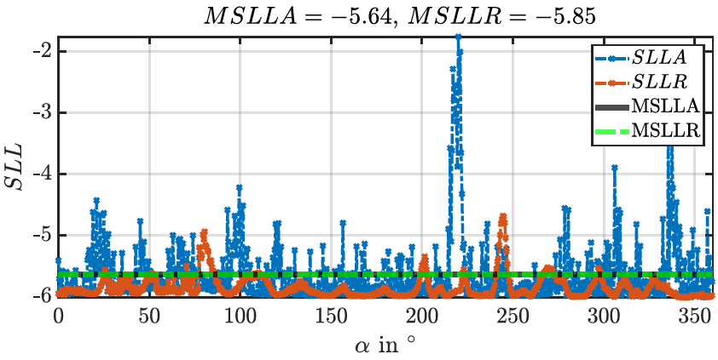
Testing Experiments
Small lift, leak of coverage
SLLA – Standardized Logarithmic Loss Angle
SLLR – Standardized Logarithmic Loss Radius
MSLLA – Mean Standardized Logarithmic Loss Angle
MSLLR – Mean Standardized Logarithmic Loss Radius

Slide 137
Testing Experiments
Small lift, leak of coverage
Strong generalization
SLLA – Standardized Logarithmic Loss Angle
SLLR – Standardized Logarithmic Loss Radius
MSLLA – Mean Standardized Logarithmic Loss Angle
MSLLR – Mean Standardized Logarithmic Loss Radius

Slide 138
Testing Experiments
Leakage weakened the generalization
Small lift, leak of coverage
Strong generalization
SLLA – Standardized Logarithmic Loss Angle
SLLR – Standardized Logarithmic Loss Radius
MSLLA – Mean Standardized Logarithmic Loss Angle
MSLLR – Mean Standardized Logarithmic Loss Radius

Slide 139
Summary
Achievements
To do's

Slide 140
Summary
Achievements
Simulation Framework
Expandability
To do's

Slide 141
Summary
Achievements
Simulation Framework
Expandability
Kernel Scaling
Generalization
To do's

Slide 142
Summary
Achievements
Simulation Framework
Expandability
Kernel Scaling
Generalization
Tolerance compensation
To do's

Slide 143
Summary
Achievements
Simulation Framework
Expandability
Kernel Scaling
Generalization
Tolerance compensation
To do's
Process minimization and limitation

Slide 144
Summary
Achievements
Simulation Framework
Expandability
Kernel Scaling
Generalization
Tolerance compensation
To do's
Process minimization and limitation
Hardware libs in C
Route to real data

Slide 145
Summary
Achievements
Simulation Framework
Expandability
Kernel Scaling
Generalization
Tolerance compensation
To do's
Process minimization and limitation
Hardware libs in C
Route to real data
Full characterization

Slide 146
Summary
Achievements
Simulation Framework
Expandability
Kernel Scaling
Generalization
Tolerance compensation
To do's
Process minimization and limitation
Hardware libs in C
Route to real data
Full characterization
Circular Statistics

Slide 147
The End
Thank you for your attention!

